Slide 1
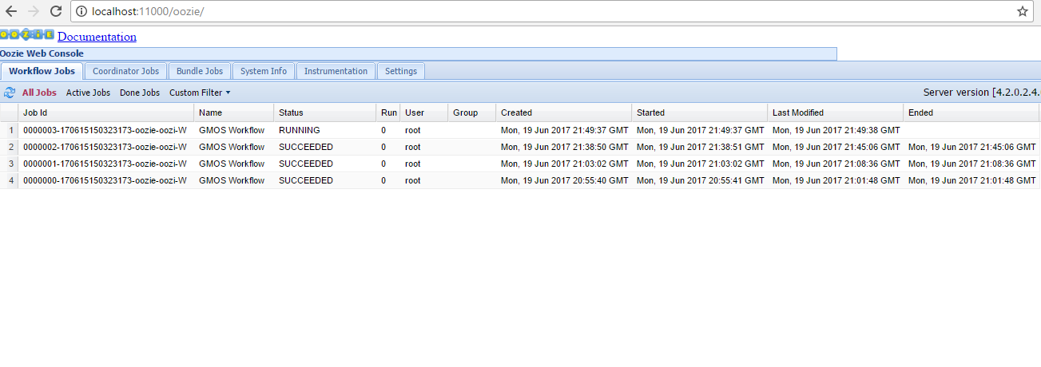
oozie job -oozie http://localhost:11000/oozie -config job.properties -run

Slide 2
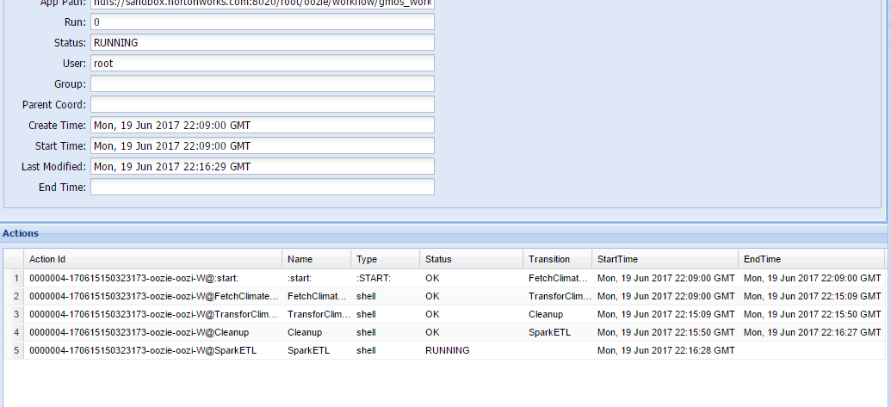
Oozie job status – Spark ETL is running

Slide 3
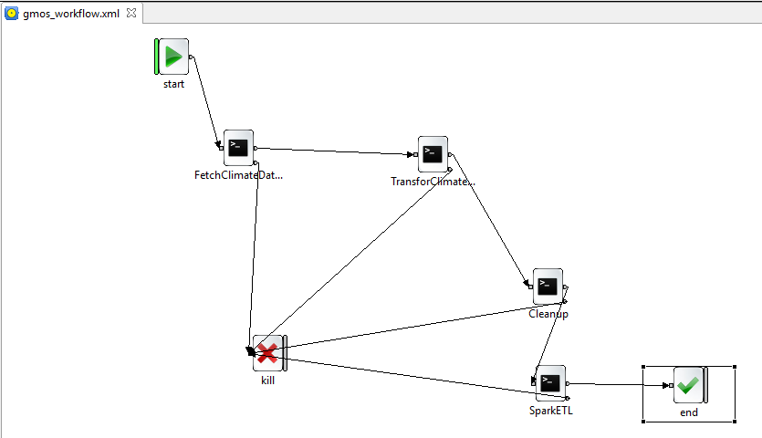
Oozie workflow

